Slide 1
Economic Networks
Mark Oussoren, Andrej Leban, Tzu Leung, Andrew Ma

Slide 2
Table of Contents
Slides 3-5: Problem Introduction
Slides 6-9: Data Preprocessing
Slides 10-13: EDA
Slides 14-15: Next Steps
Slides 16-25: Appendix

Slide 3

Our Problem:
How do idiosyncratic supply-side shocks permeate the US Economy?

Slide 4
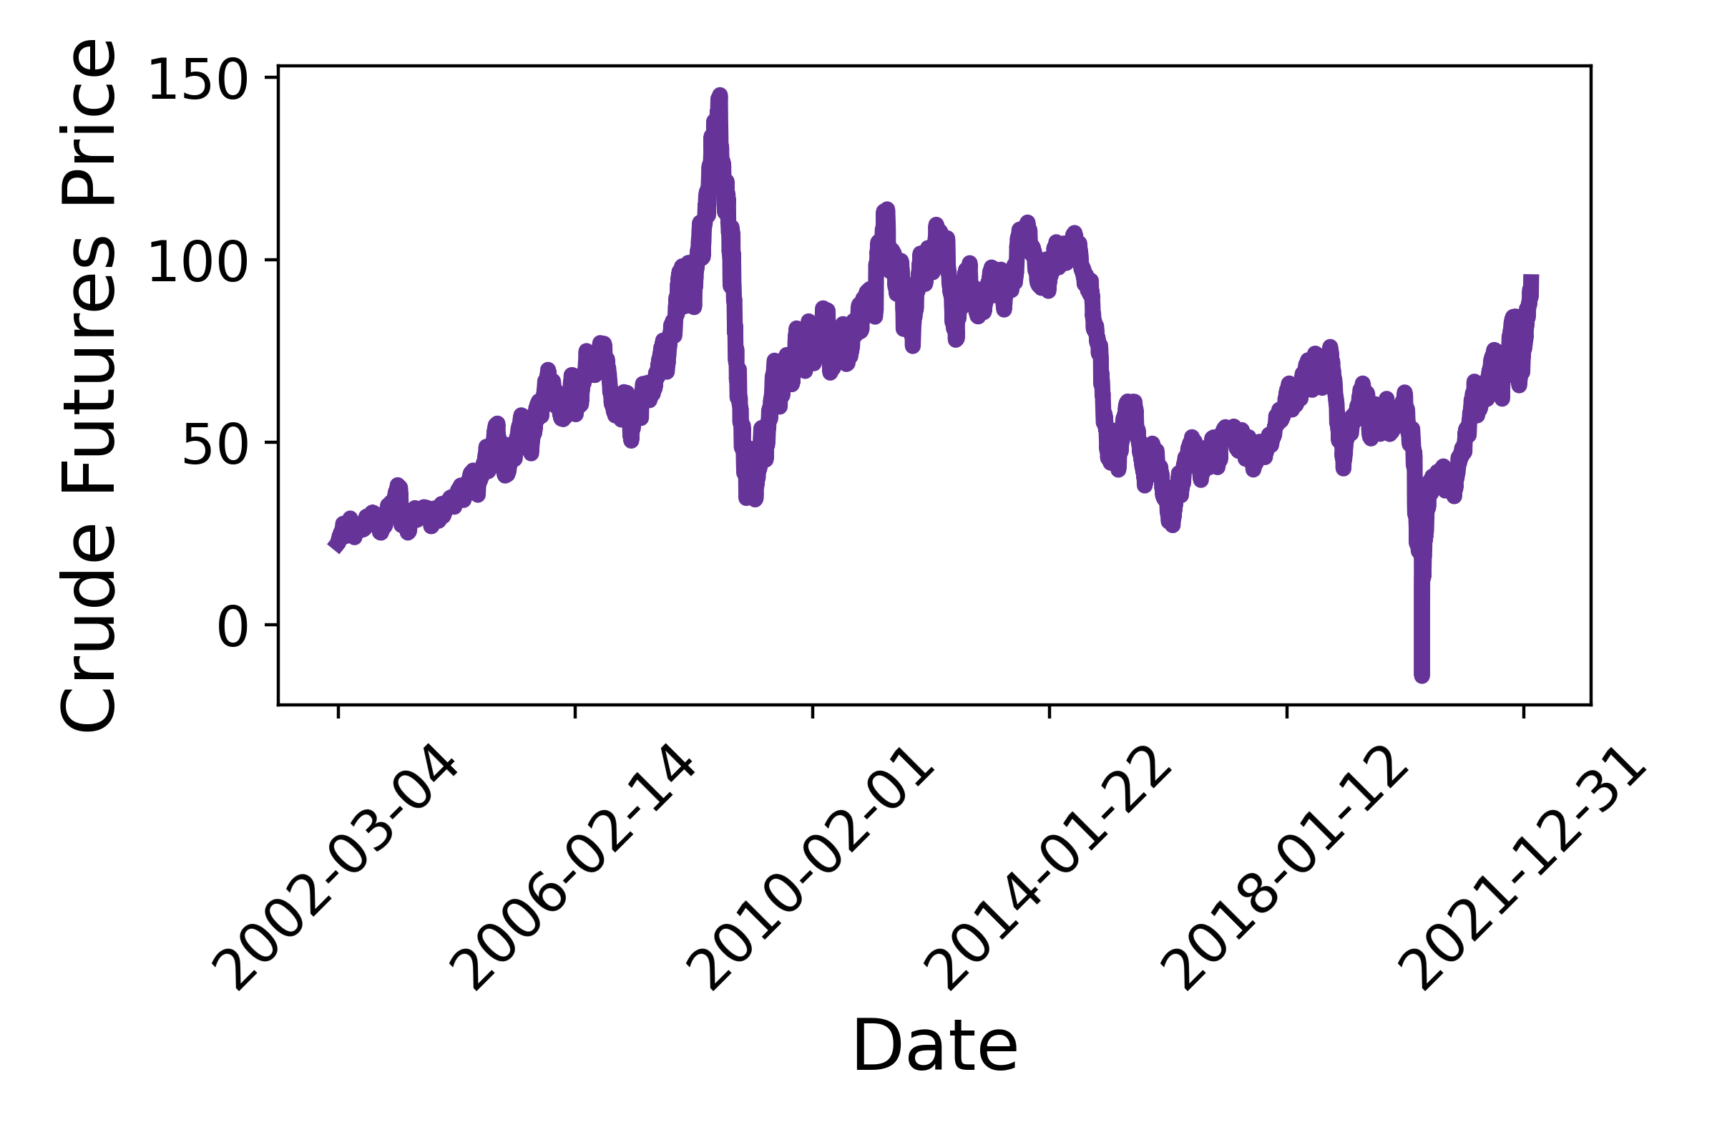
Idiosyncratic Supply-Side Shocks
Definition: Idiosyncratic Shocks | Shocks that affect a specific subset of firms.
Nonexamples | ‘08 Crisis, COVID-19, World Wars, etc.
Examples | Terrorism, Cyber Attacks, Natural Disasters – forest fires, earthquakes, etc.
COVID19 + OPEC-Russia Price Wars

Slide 5


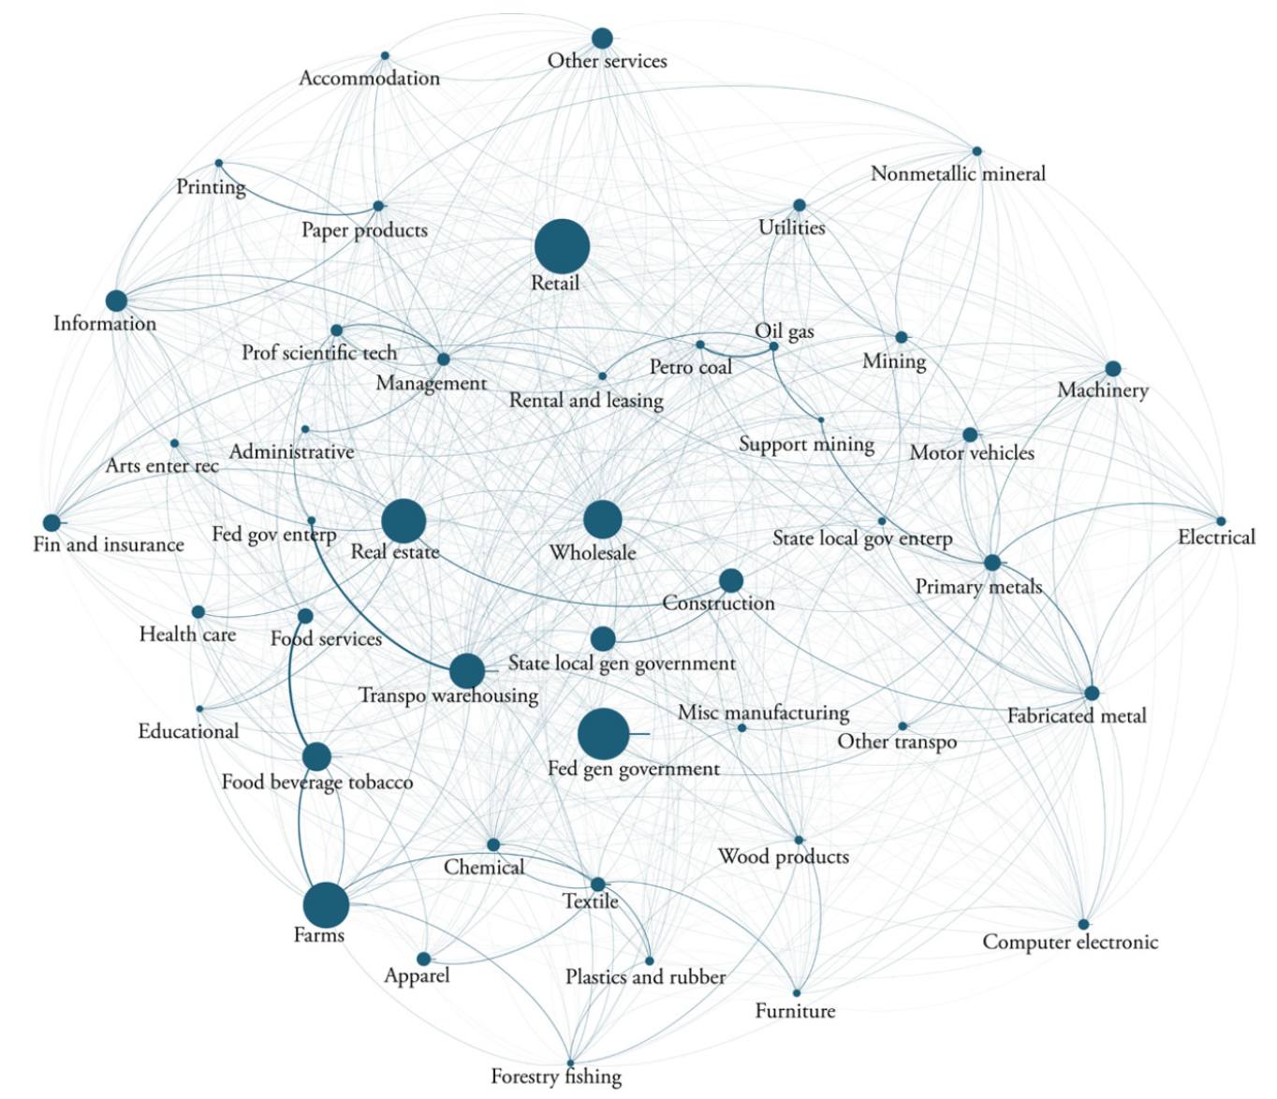

Formal Objective
We would like to analyze and deconstruct the effect of a sector-specific (idiosyncratic) supply-side shock as it traverses through the economy
Drawing motivation from (Acemoglu et al., 2015), we would like to explore theoretical simulations and perturbations of the network – akin to stress testing done by banks
Time-permitting, we would also like to explore historical realizations of supply-side shocks – natural disasters, cyber attacks, etc. as discussed in (Foerster & Choi, 2017) and (Crosignani et al., 2020)
(Foerster and Choi, 2017)

Slide 6

Data Preprocessing:
All about our data, the quality, and steps taken to help answer our question.
z

Slide 7
Data Description
The data is developed by the Bureau of Economic Analysis (BEA) which is an agency under the Department of Commerce
Available here for download
The data is rounded to the nearest million and collected annually back to 1947 (though commodity descriptions have changed)
Due to the data being annual, we severely constrained in our analysis to a small subset of historical supply-side shock examples (forest fires in California, swine flu, etc.)

Slide 8
Understanding Input Output (IO) Tables
Developed by Soviet-American economist Wassily Leontief
IO tables capture the exchange of goods between suppliers and consumers
Here’s a simple example
 |  | Buying Sector
 |  | Farms | Petroleum | Total Commodity Output
Selling Sector | Farms | $11M | <$1M | $12M
 | Petroleum | $200M | $100M | $300M
 | Total Industry Output | $210M | $102M | $312M
How much Farms spends on industries for production
How much industries spend on Farms for production

Slide 9

Data Cleaning for IO Tables
‘…’ values in the tables are imputed with 0 – these values represent dollar amounts less than $1M
We focus on IO data from 1997-2020 as earlier data have different industry definitions and names
{‘1997’: IO_table1, … , ‘2020’: IO_table24} $⇒$ IO table with a column denoting year of table as seen below:
Year | Name | Farms | Petroleum | Total Commodity Output
1997 | Farms | $11M | <$1M | $12M
1997 | Petroleum | $200M | $100M | $300M
1997 | Total Industry Output | $210M | $102M | $312M

Slide 10

Exploratory Data Analysis:
Here we play with the data to garner more intuition for modeling and ultimately answering our question.

Slide 11
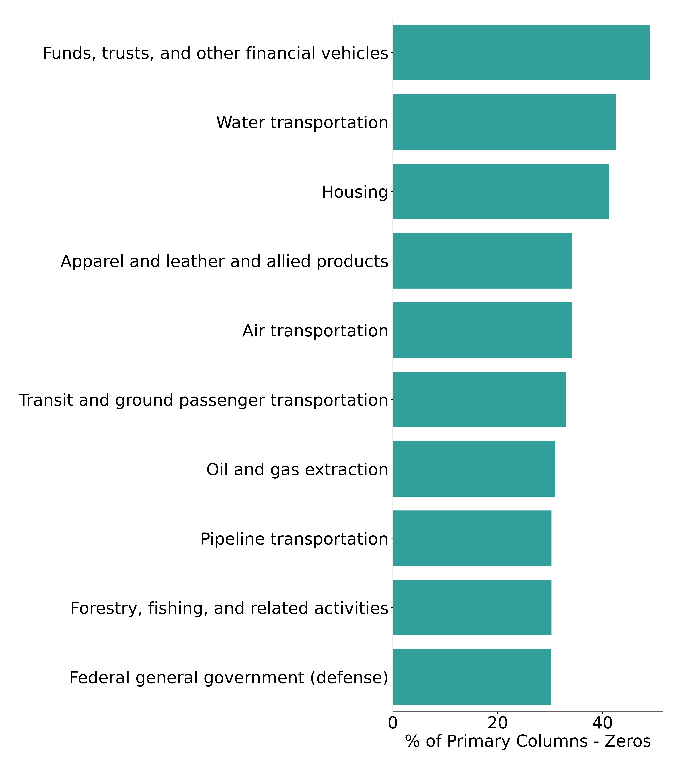
Data.describe() - % of Zeros per Column
Primary Industries - Most Zeros
Housing Spending
Intuitively funds don’t need to spend on many other industries
This doesn’t intuitively make much sense – housing *should* require the products in many industries

Slide 12
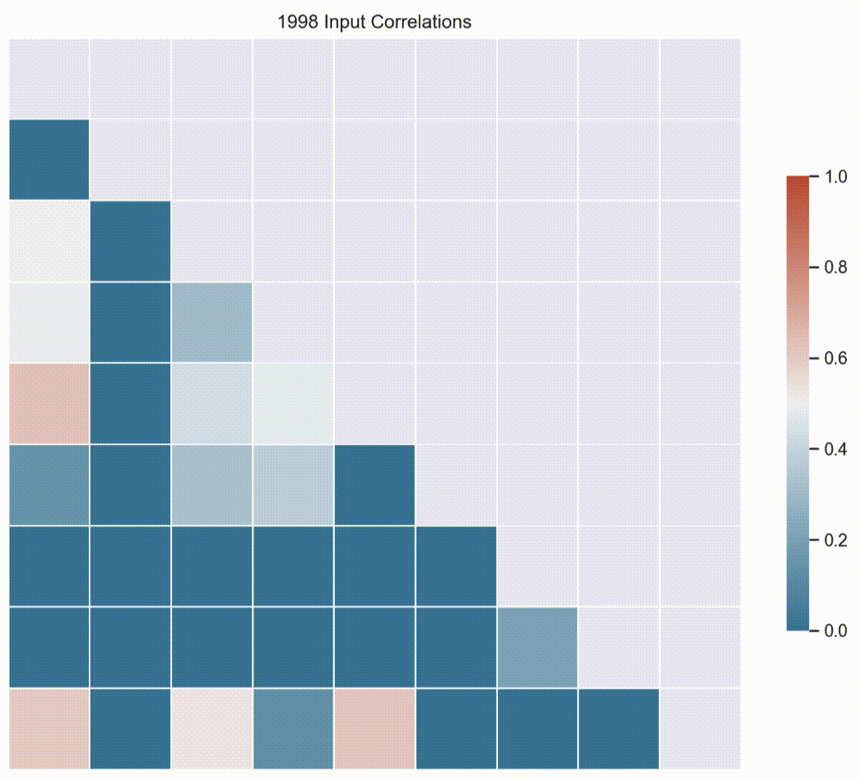
Data.describe() – Input Correlation Invariance
This is a small subset of industries comparing input correlations over time
There are shifts in the correlations of the industries, but generally steady
This is promising for later analysis of possible steady-state industry dynamics

Slide 13
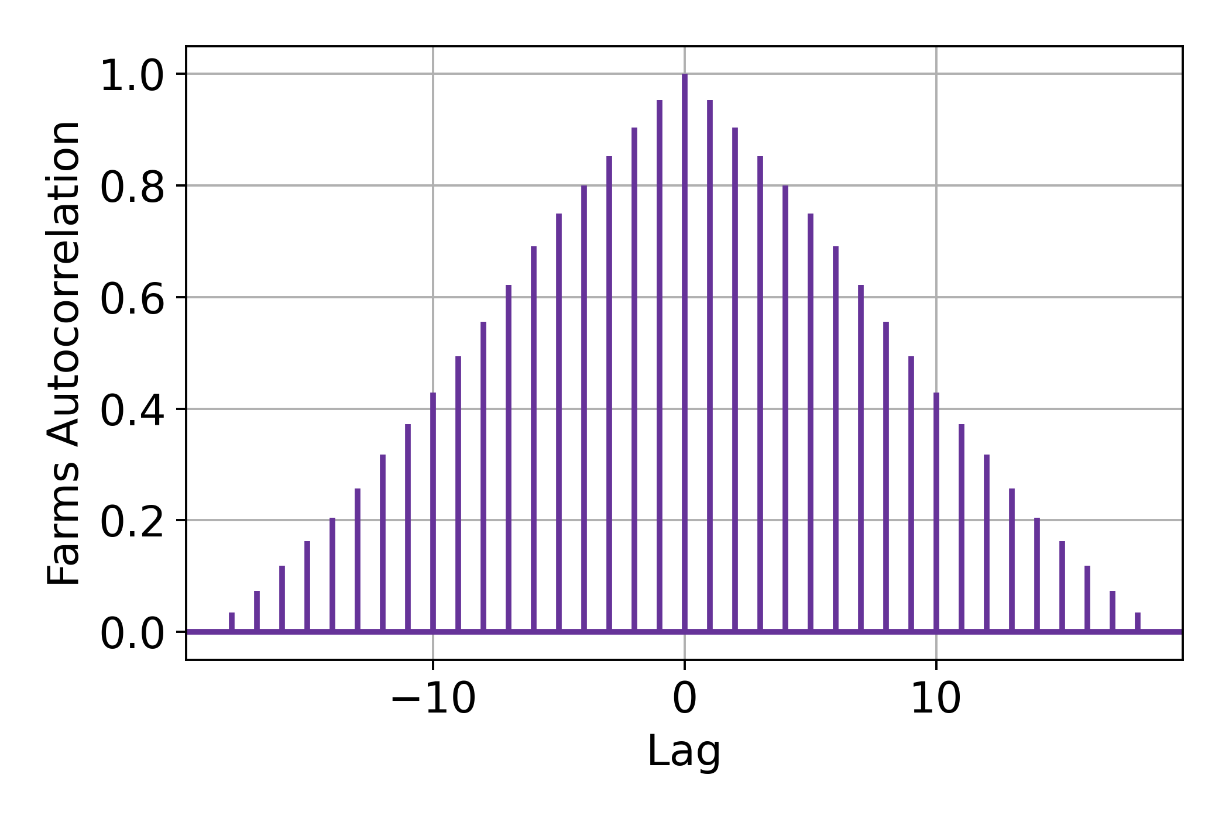
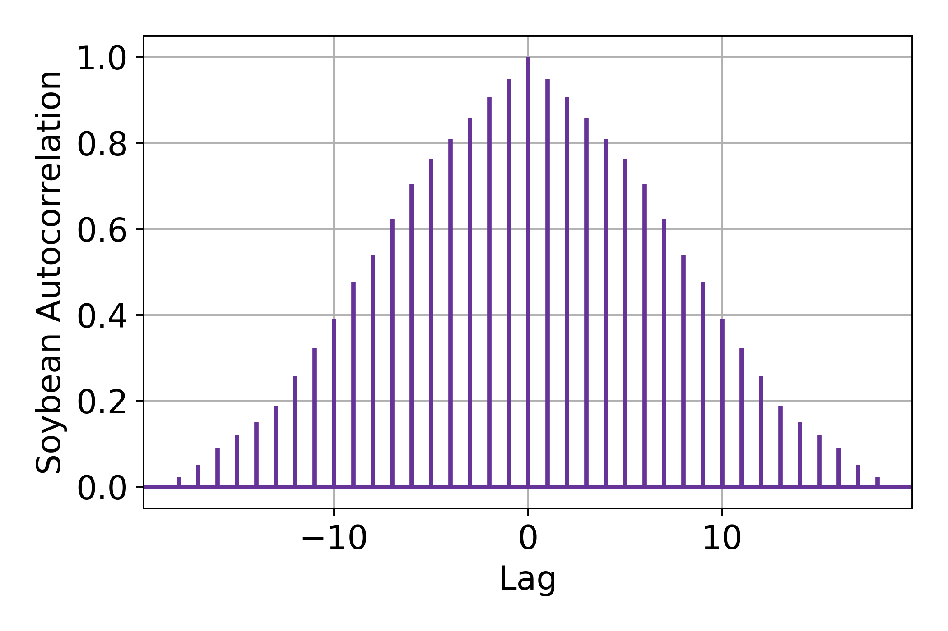
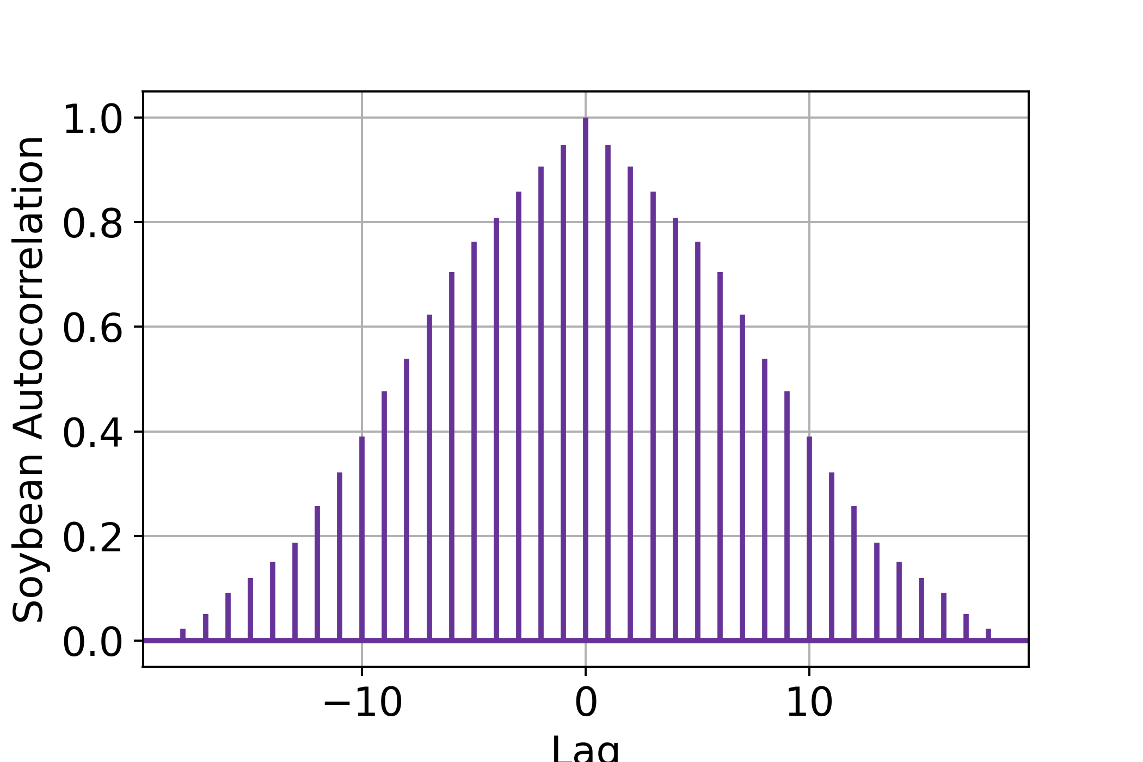
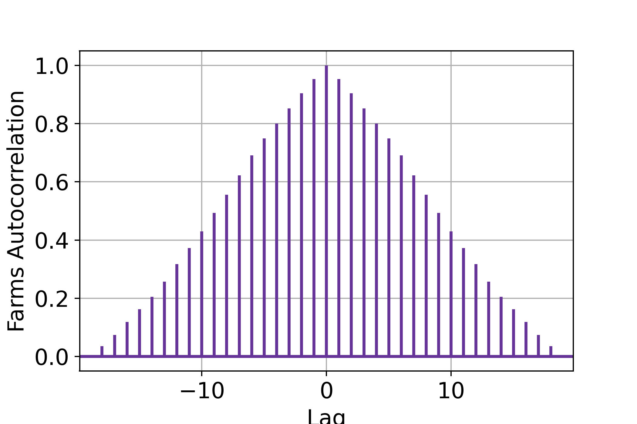
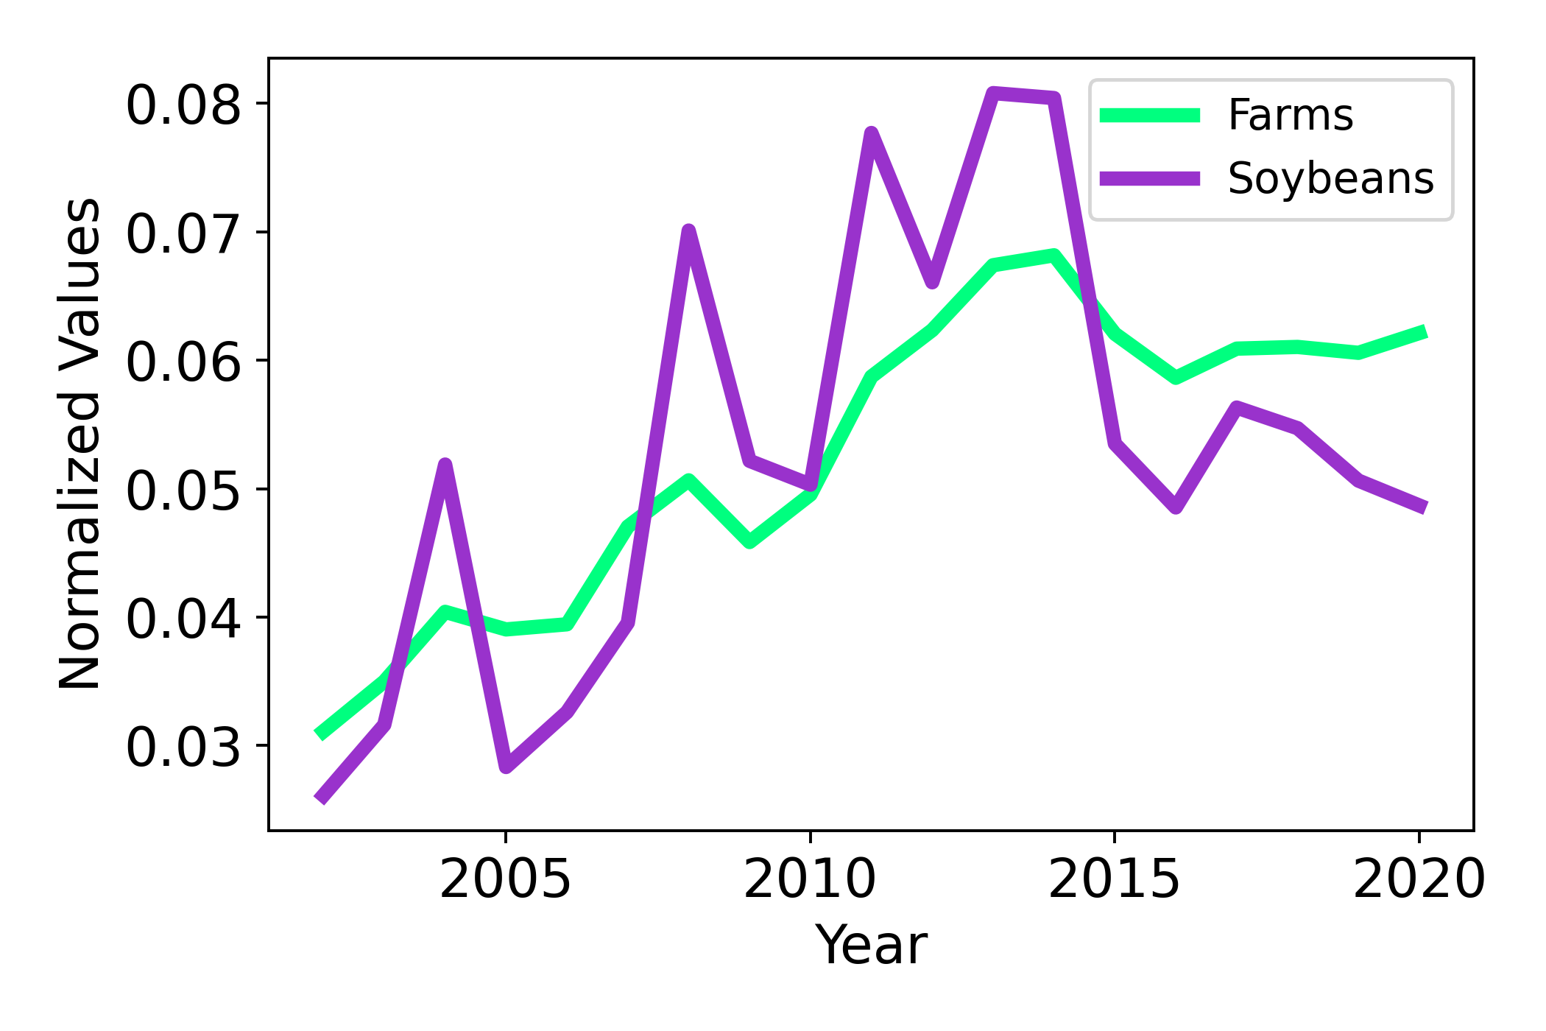
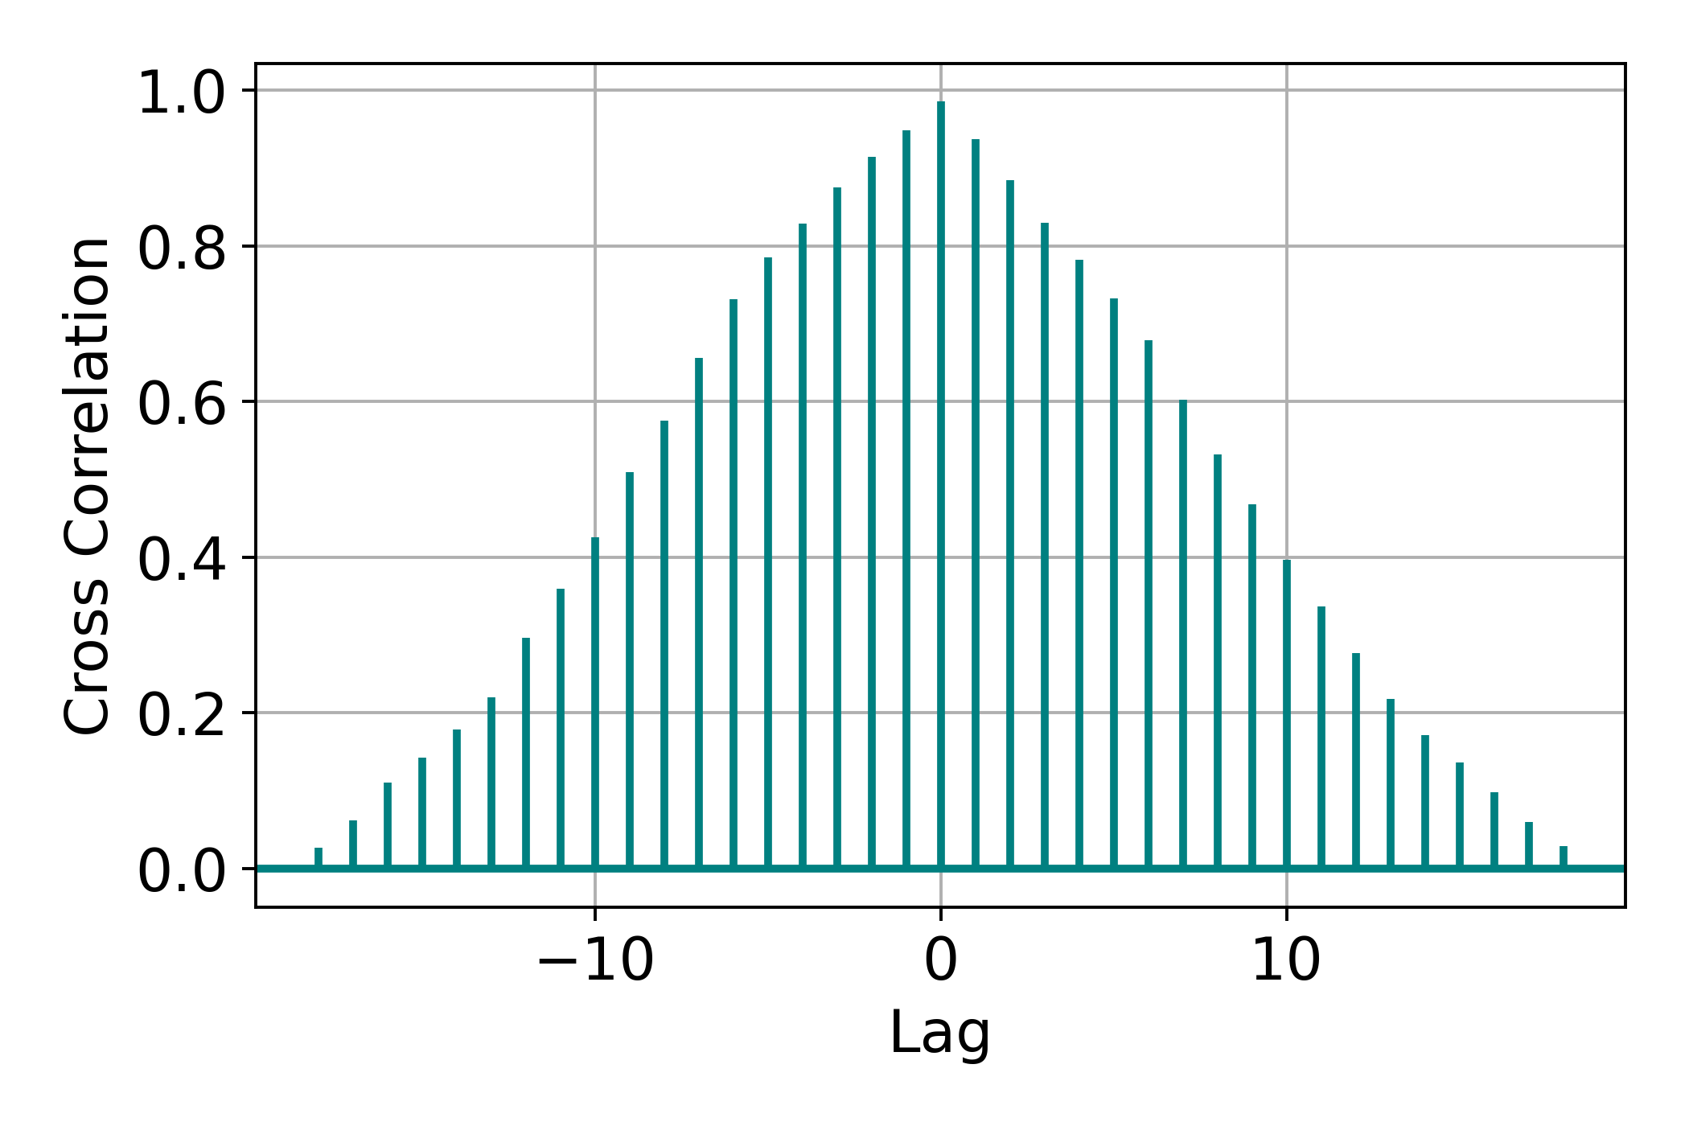

Data.describe() – Relationship with Futures
z
Price Evolution
Autocorrelation Structures
To reiterate our goal: we want to understand the flow and distribution of goods after crises rather than mere correlations and price changes.
$Cov\left(X_{t},X_{t−k}\right)≈Cov\left(Y_{t},Y_{t−k}\right)$
The stochastic processes mirror each other – our goal is not forecasting as Futures data is more suitable

Slide 14

Next Steps
Finally, we detail our next steps in tackling the problem.

Slide 15
Next Steps
Implement and simulate the network in a variety of realistic scenarios
Analyze and infer macroeconomic properties of the network structure
Examine the network structure under historical examples of supply-side shocks

Slide 16
Appendix
z

Slide 17
Data.describe()
There are 94 columns (excluding year and name):
71 represent an industry’s (a row) spending on other industries (as in the earlier example) whose sum equals column ‘Total Intermediate’
21 represent “secondary” industry spending (exports/imports of goods, IP investments, etc.) whose sum equals column ‘Total Value Added’
Finally, the last column is given by ‘Total Commodity Output’ which is the sum of ‘Total Intermediate’ and ‘Total Value Added’
There are 79 rows:
73 represent other industries’ spending on an industry (column)
3 represent “secondary” industries that spend on the industry (wages, operating surplus, etc.)

Slide 18
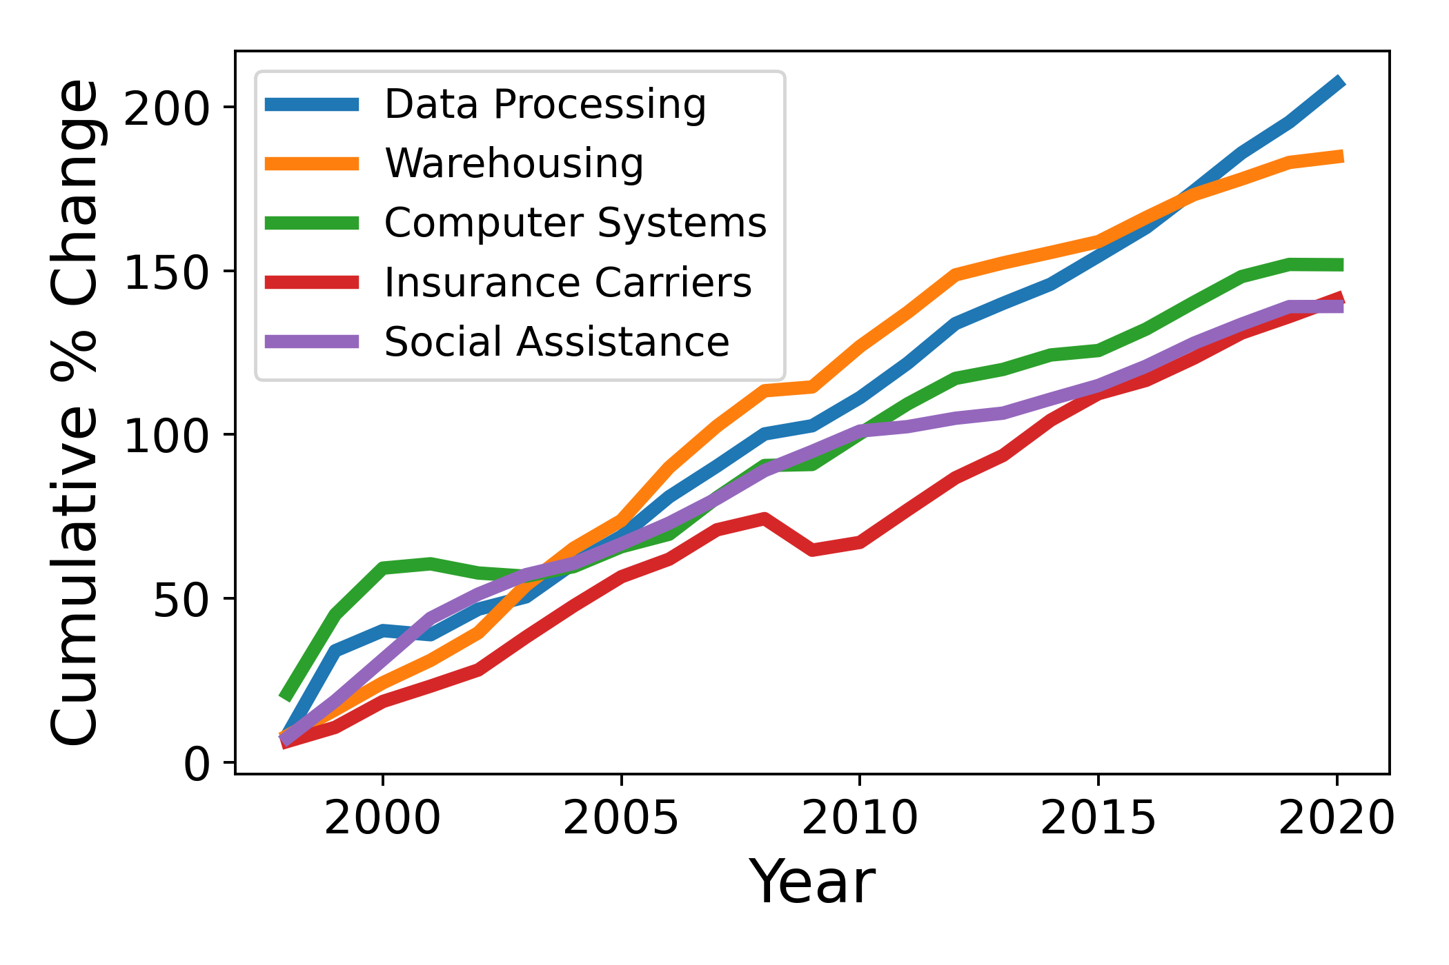
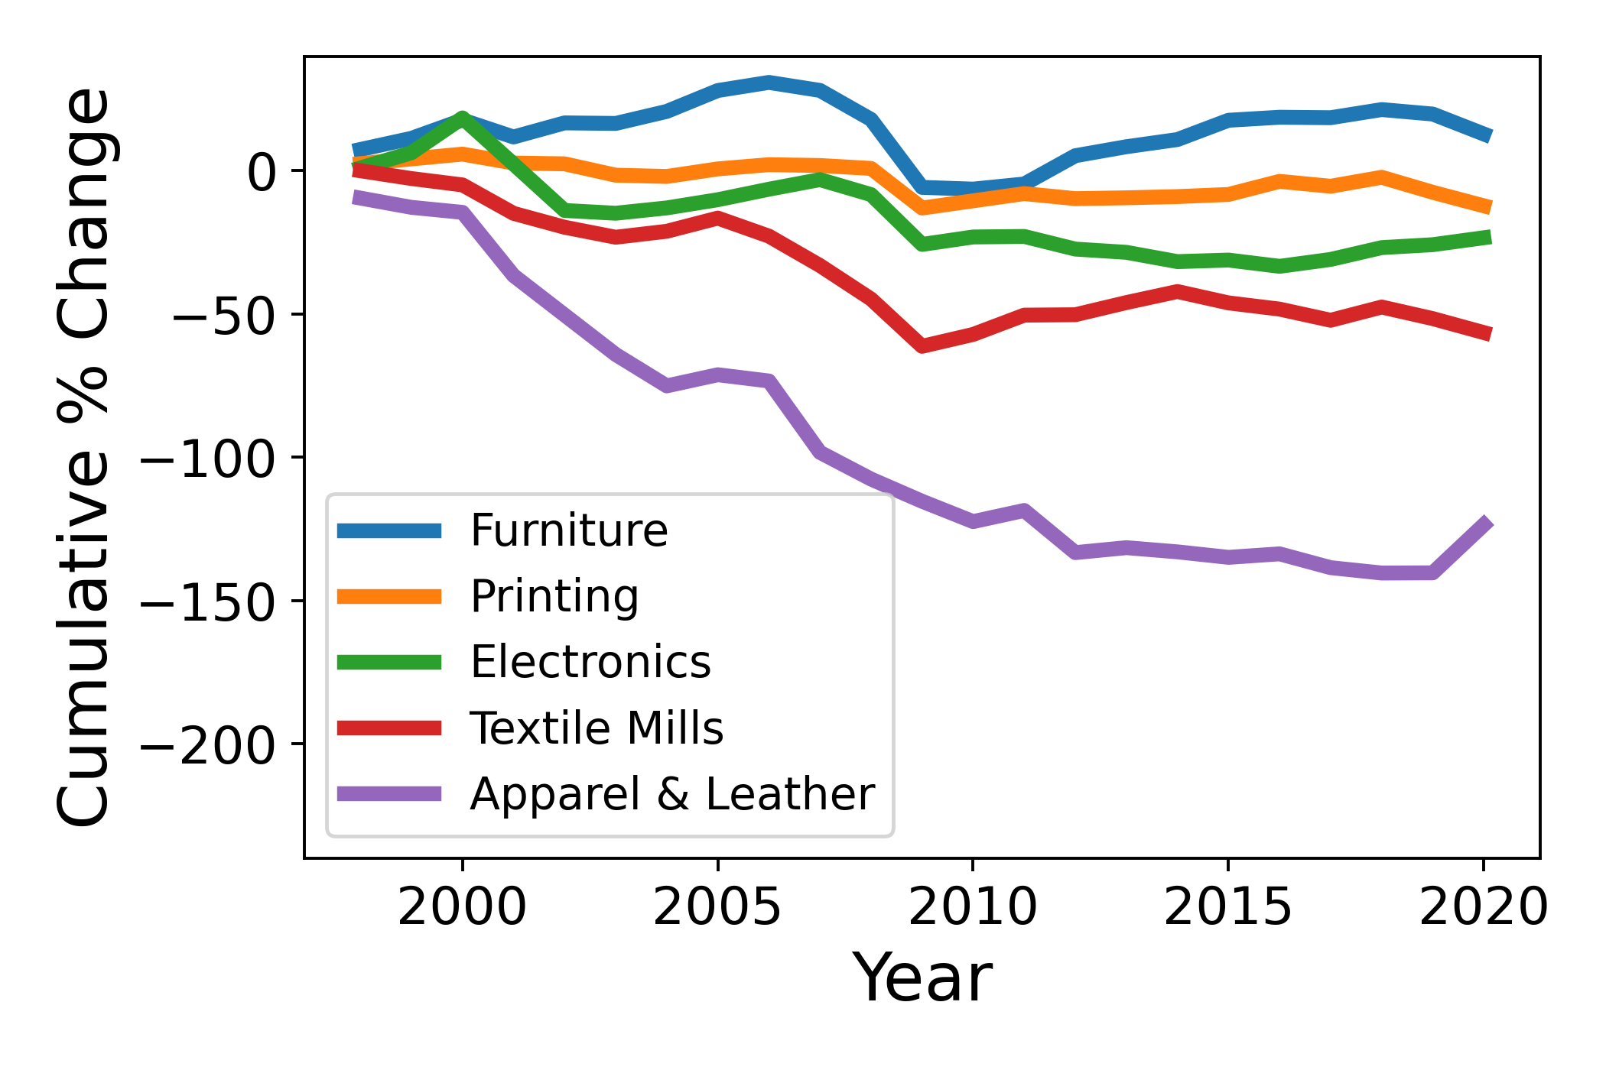
Data.describe() – Commodity Output Changes
5 Largest Output Increases
5 Largest Output Decreases
Here we see the computing and technology sector growth story spanning the last two decades – consuming much more from other industries

Slide 19
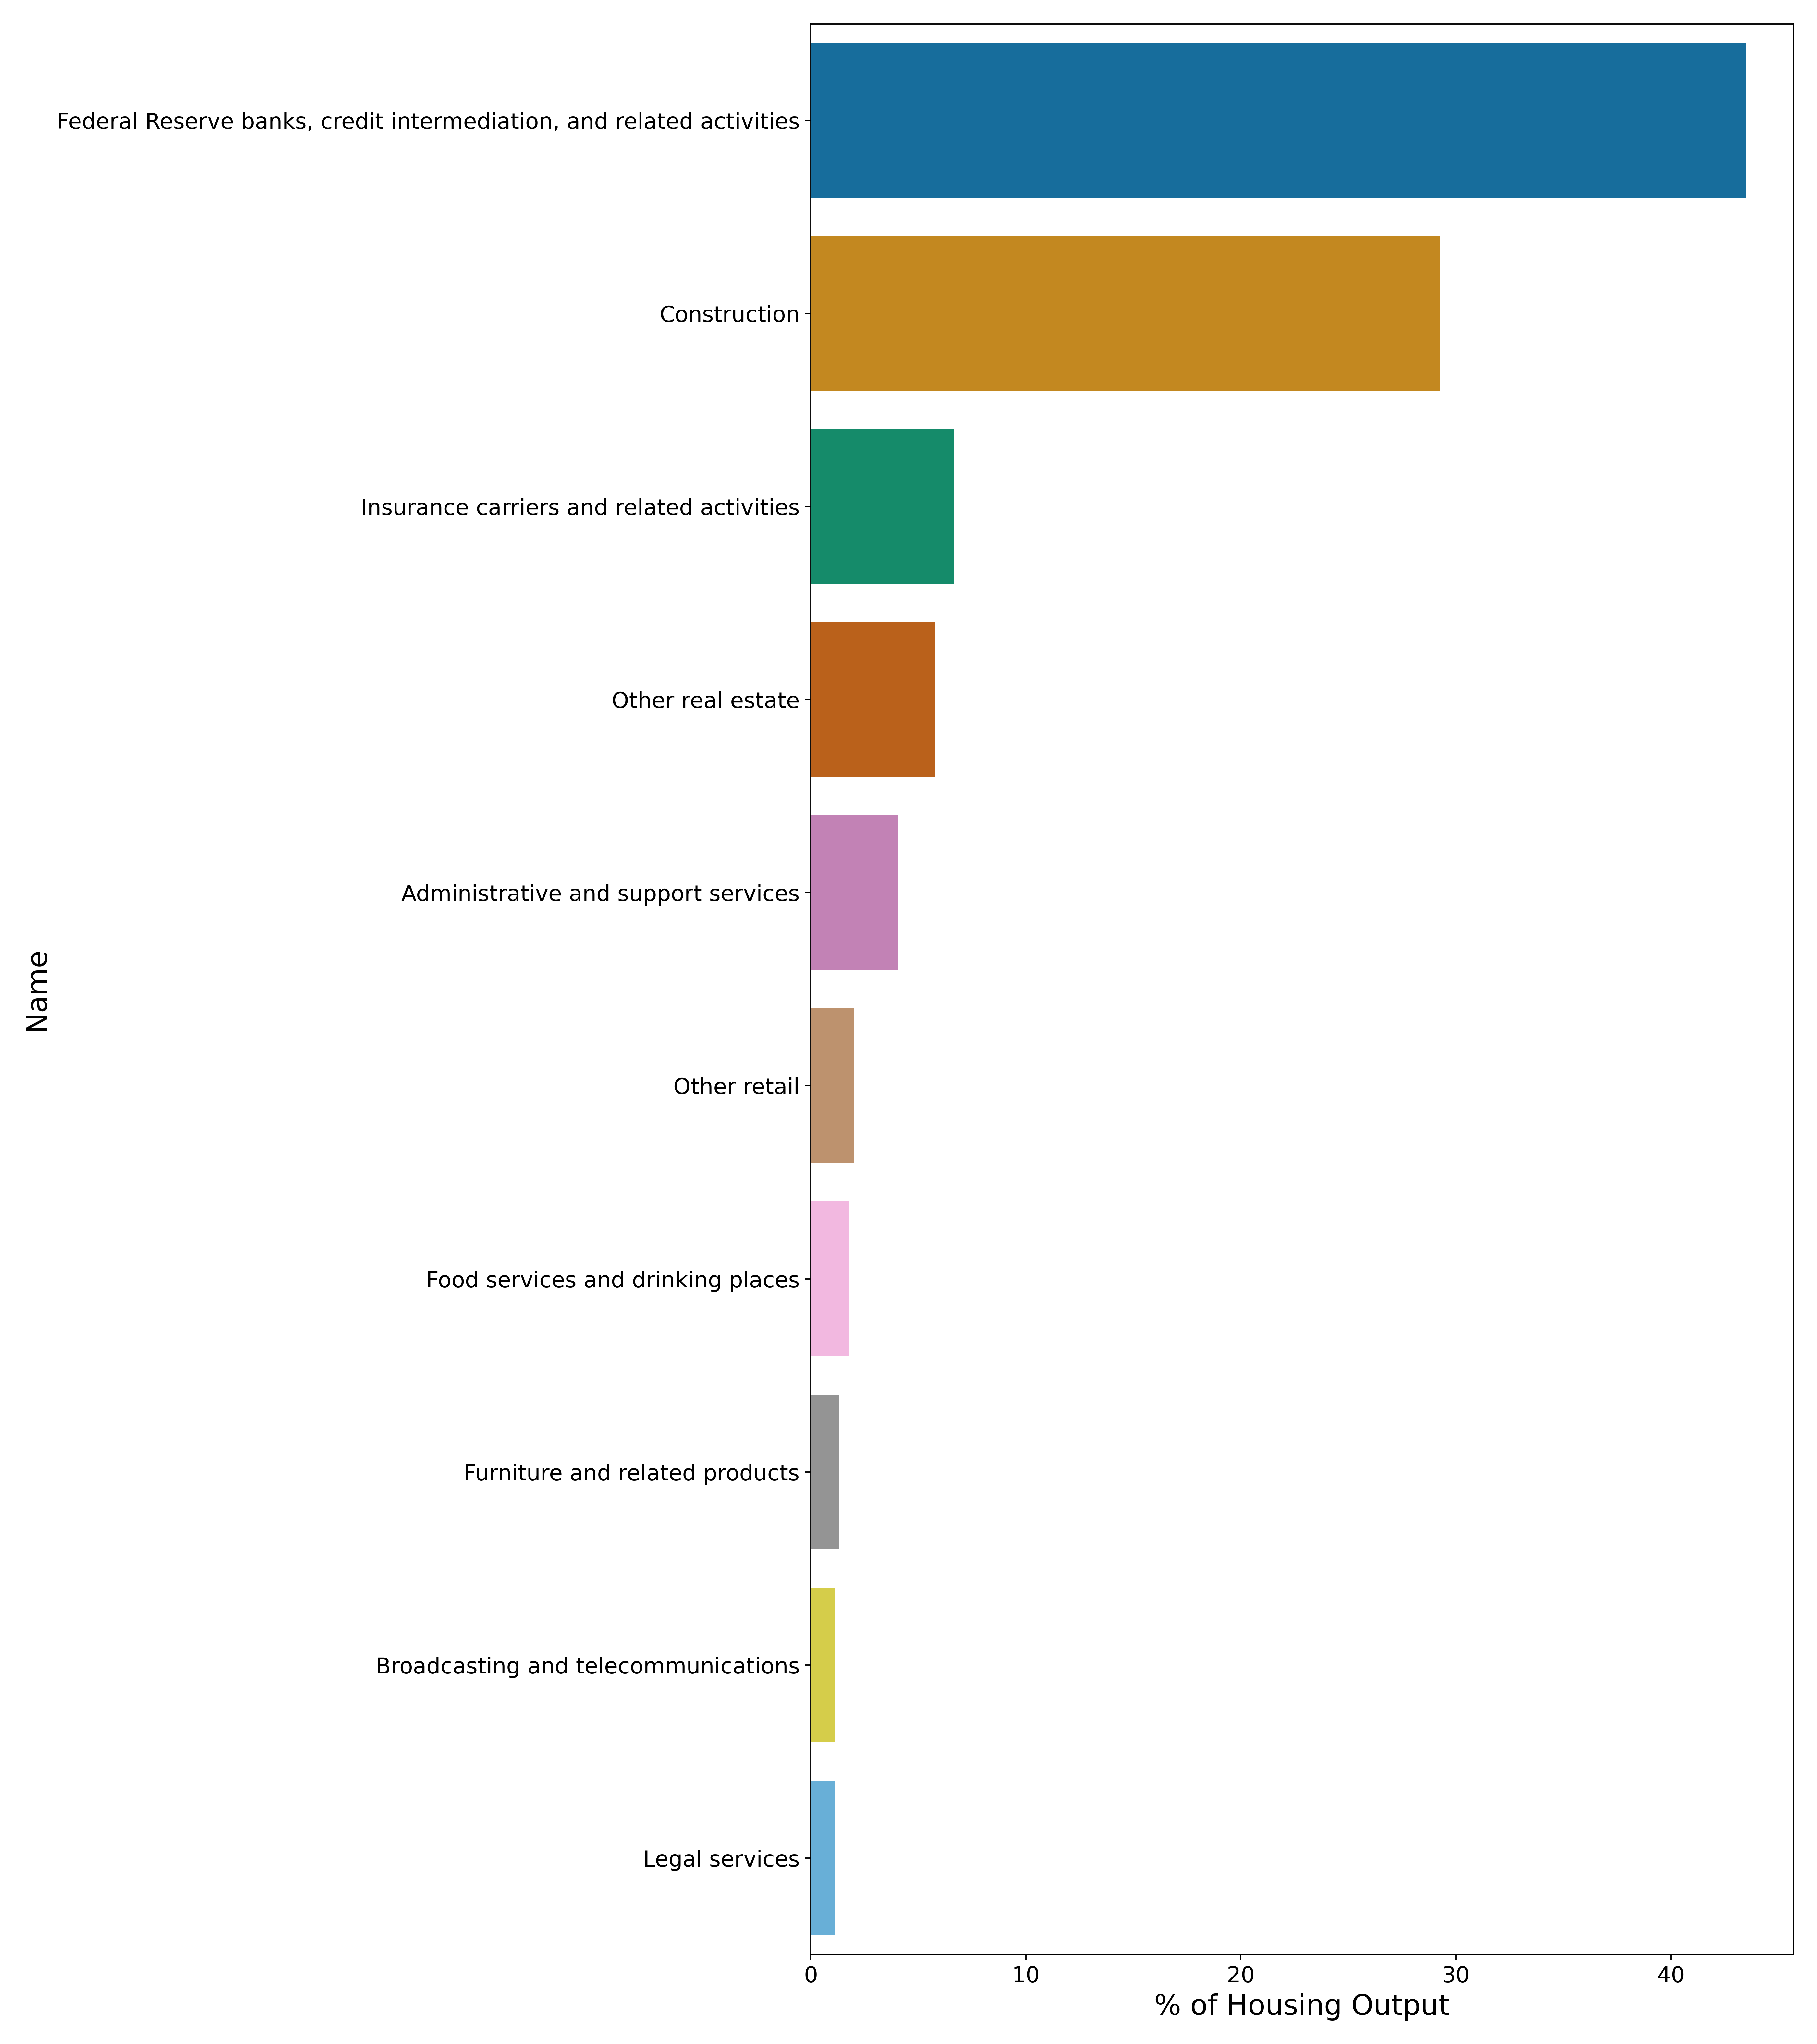
Data.describe() – Housing Output Breakdown
The Fed makes up most Housing purchases – most likely through mortgages which makes sense
Food services and retail intuitively rely on housing
How does this industry differ with real estate and other related industries?

Slide 20

Graph Basics
A graph $G$ is an ordered triple $(V\left(G\right), E\left(G\right), ψ_{G})$ consisting of vertices $V(G)$, edges $E(G)$, and an incidence function $ψ_{G}$ that assigns a set of vertices to each edge
In this example
Vertices = {Farms, Lumber, Petroleum,
Computer Systems, Utilities}
Edges = {1, 2, 3, 4}
$ψ_{G}\left(1\right)=$(Farms, Petroleum)
$⋮$
$ψ_{G}\left(4\right)=$(Lumber, Petroleum)
Petroleum
Farms
Computer Systems
Utilities
Lumber
1
4
2
3

Slide 21
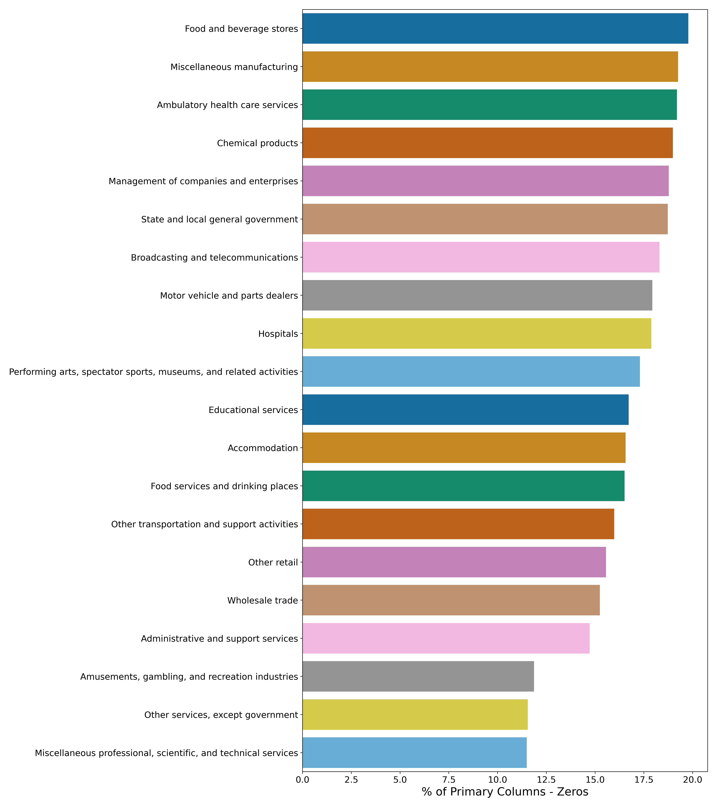
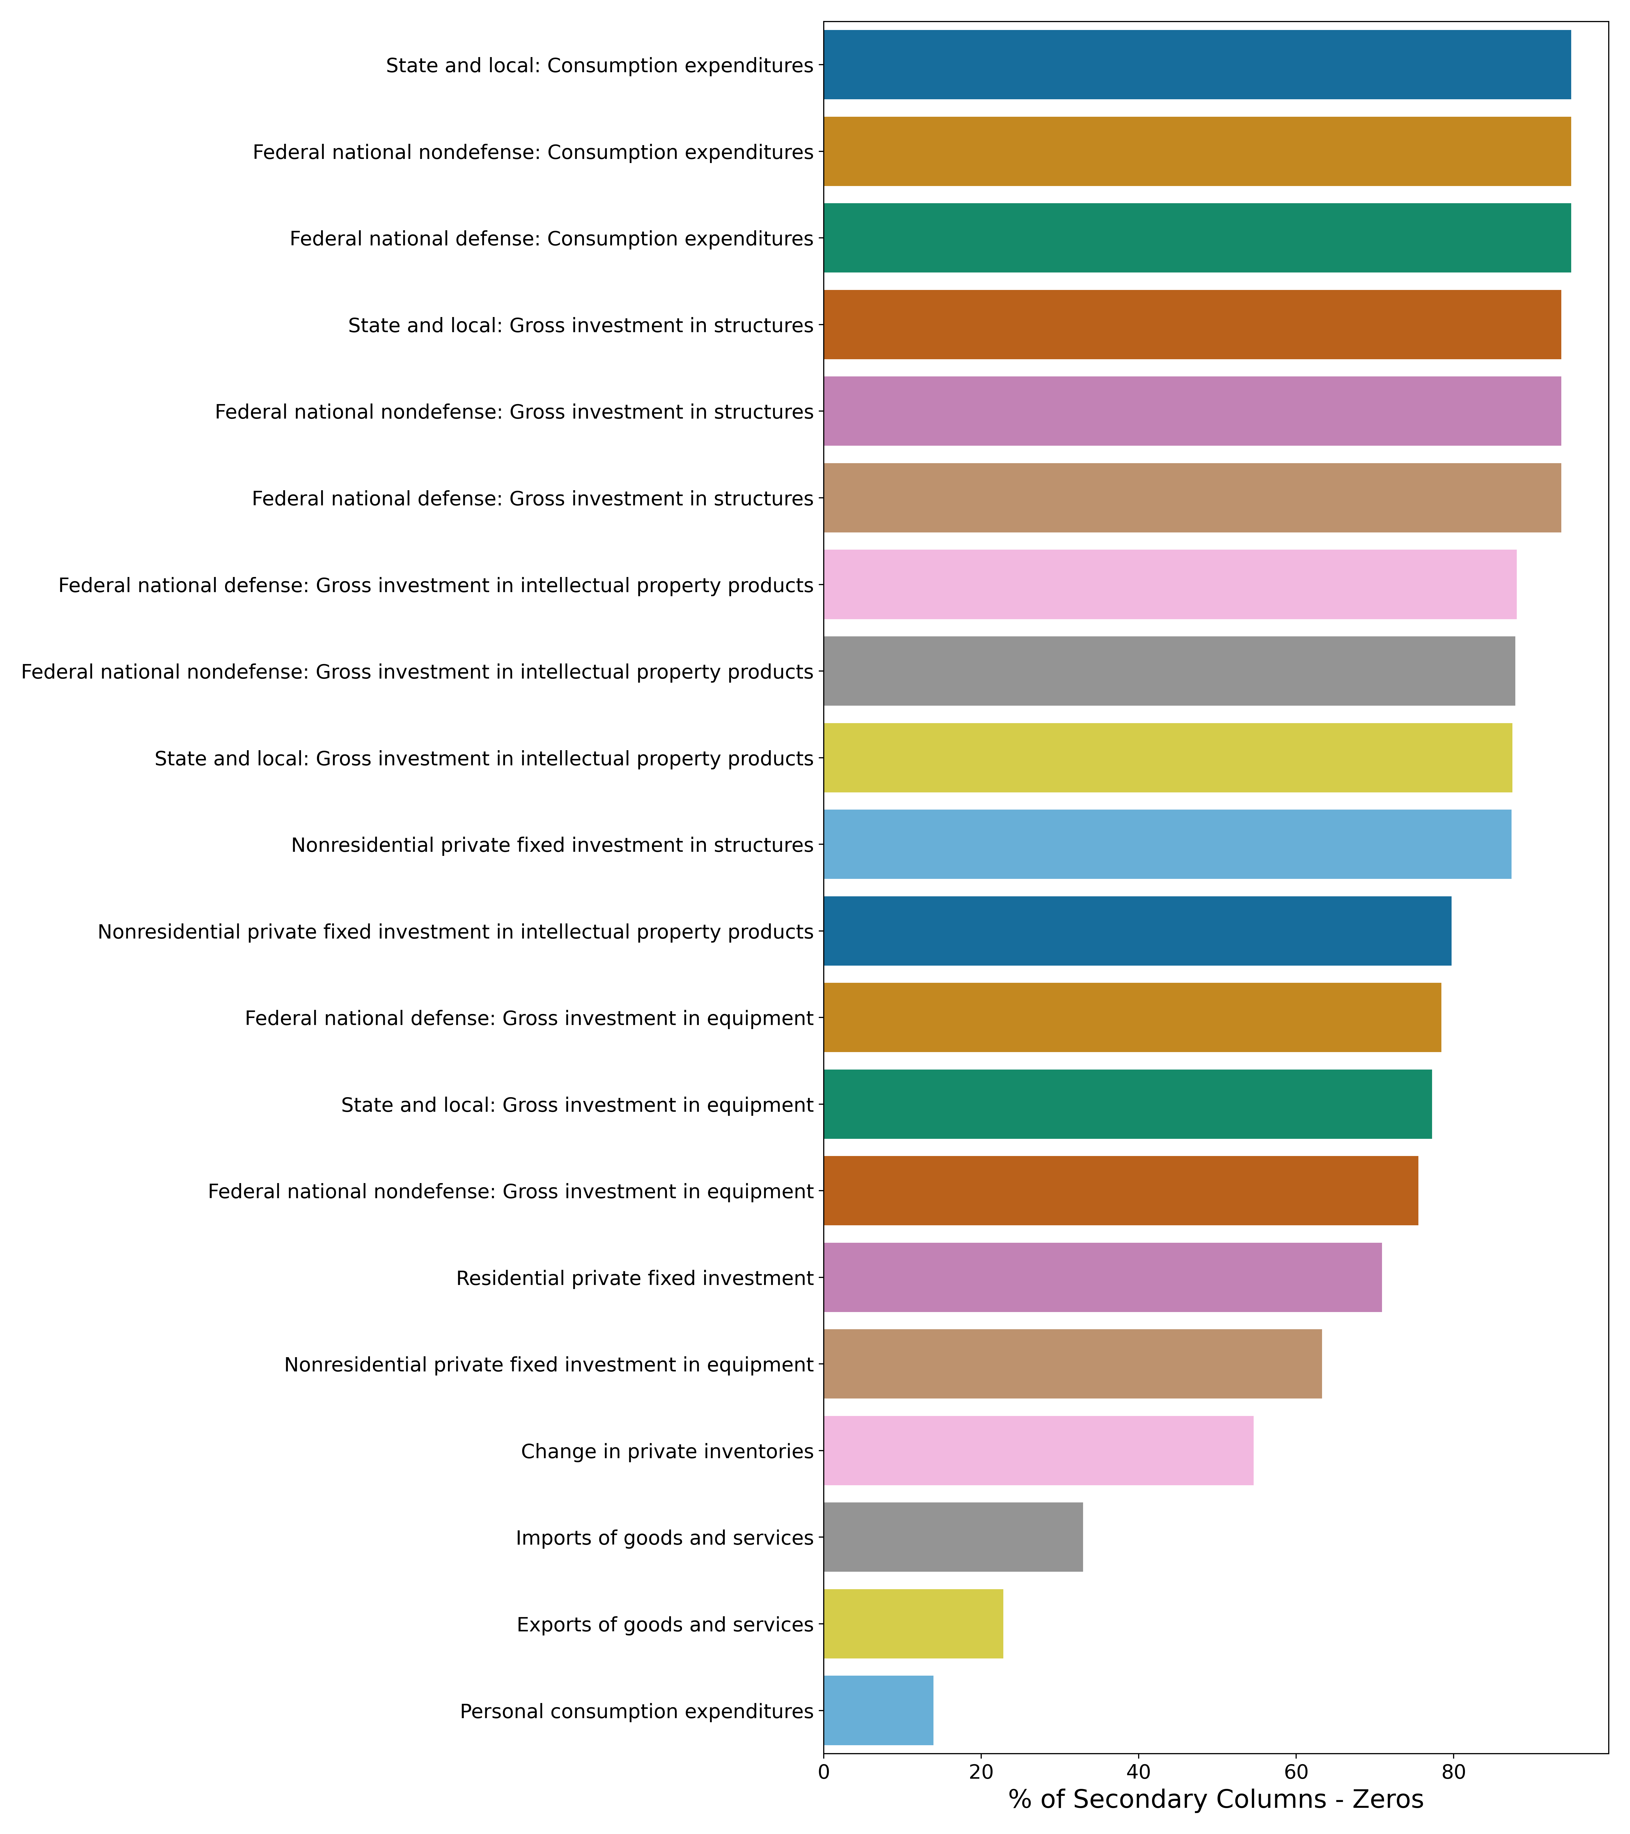
Data.describe() - % of Zeros per Column
Primary Features
Secondary Features
I guess many industries require professional, scientific and technical services?
Notes:
Smallest count of zeros

Slide 22
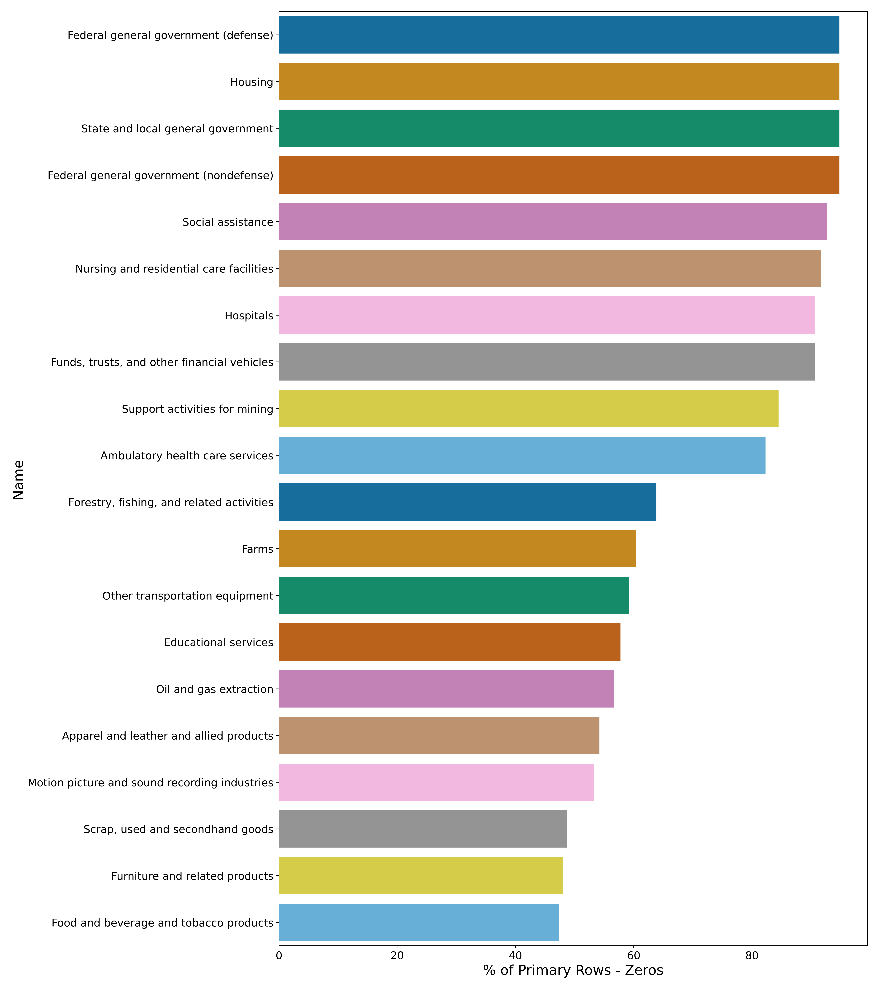
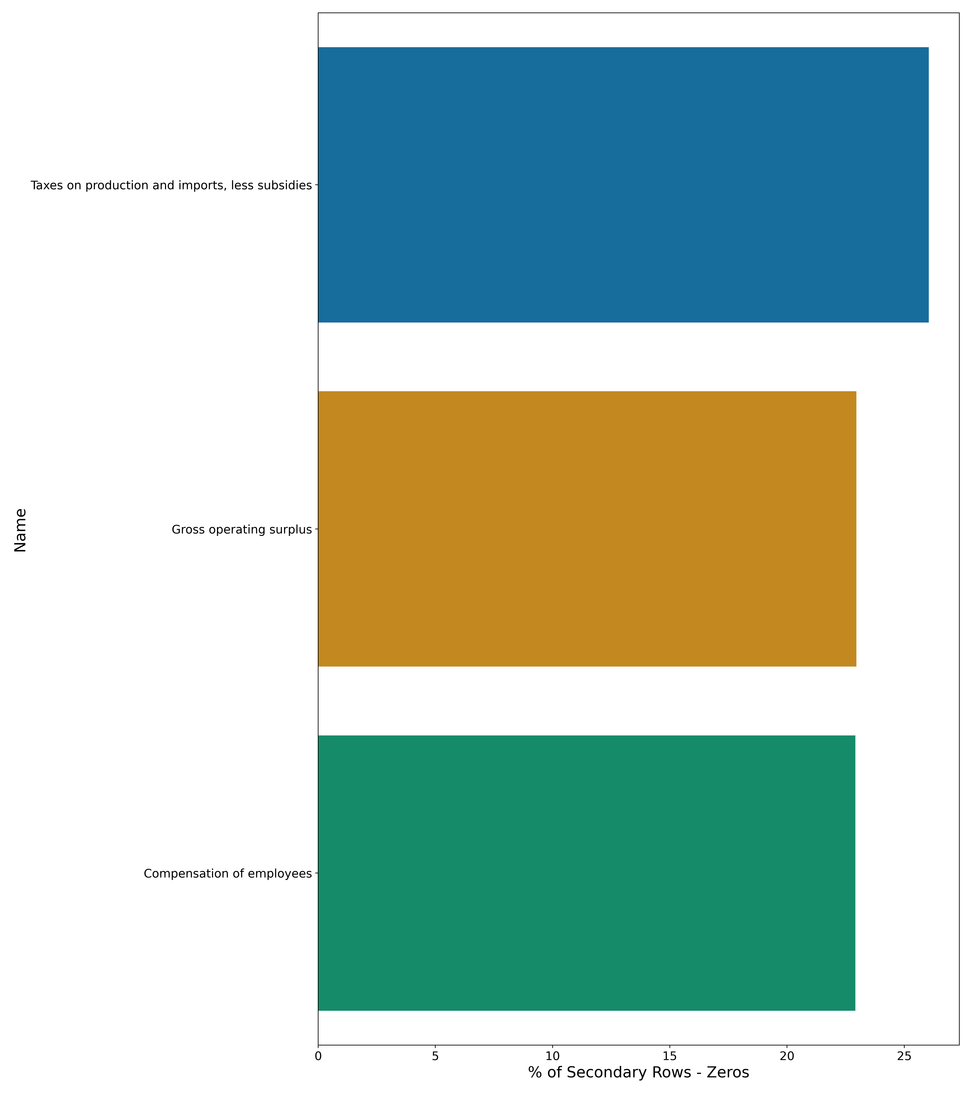
Data.describe() - % of Zeros per Row
Primary Features
Secondary Features
Intuitively, defense should need resources from many of these industries – what gives?
Housing is different from construction – this is like home improvement
Notes:
Largest count of zeros per row

Slide 23
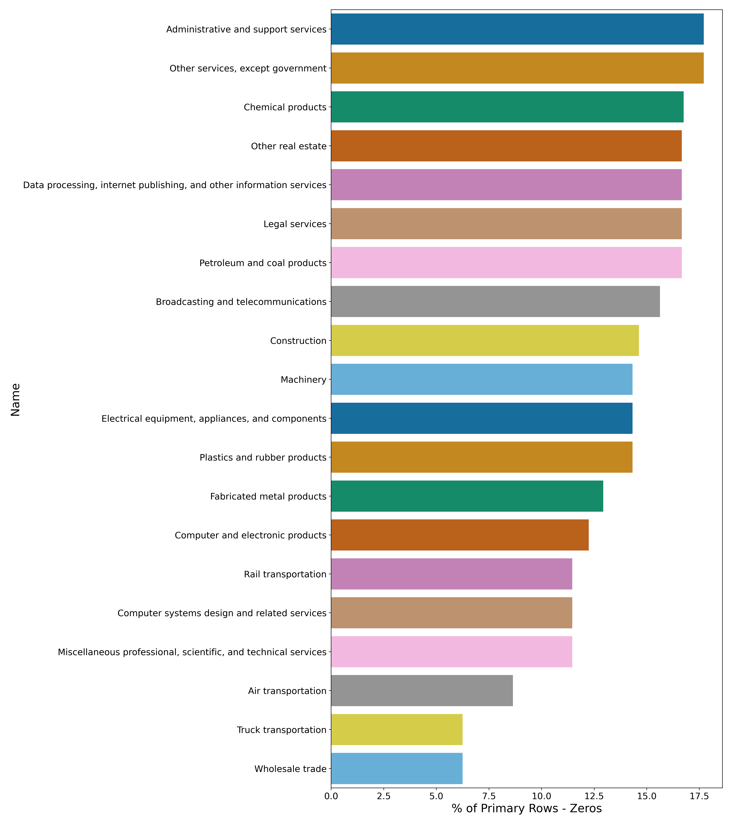
Data.describe() - % of Zeros per Row
Primary Features
Secondary Features
Wholesale trade has the least number of zeros – it uses many industry products
Notes:
Smallest count of zeros per row

Slide 24
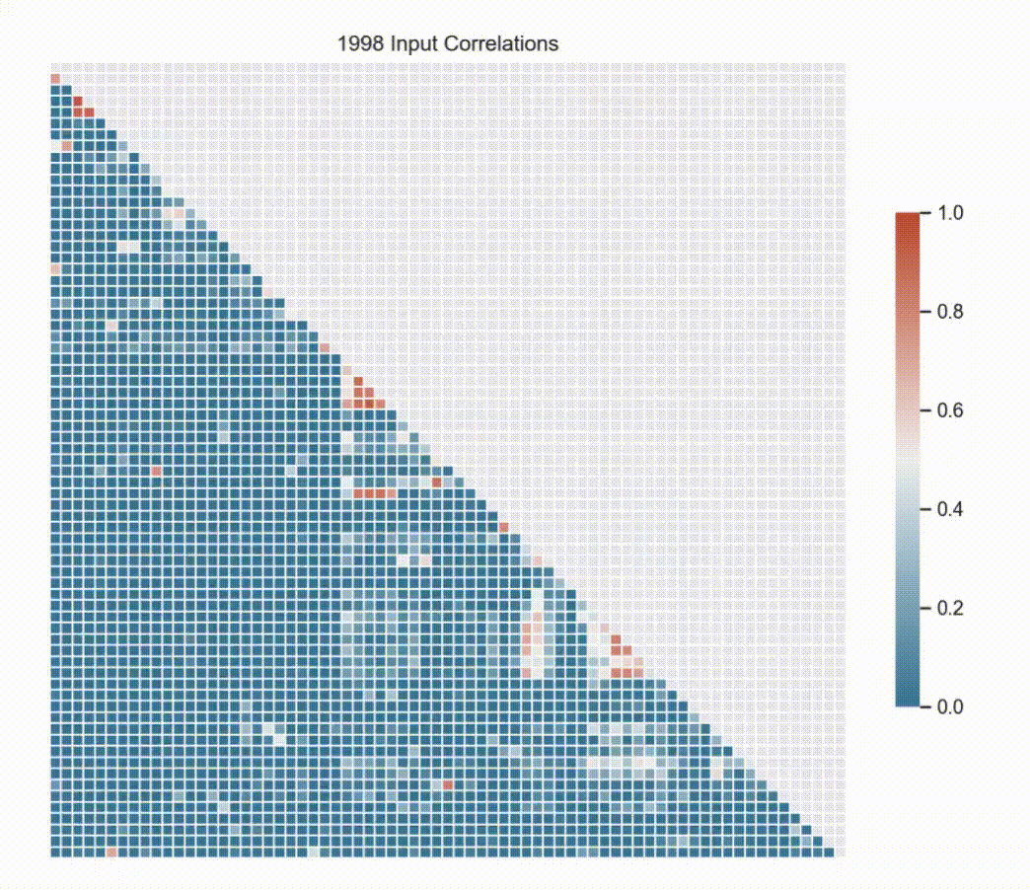
Data.describe() – Commodity Input Invariance
Input correlations amongst industries remains relatively invariant over time with a few select industries shifting over time

